Slide 1


Using Banner for Concurrent Enrollment Registration
Chelsie Rauh, Early College Program Director, NACEP 4-Year Public Postsecondary Board Representative
Laura McKenzie, University Registrar Idaho State University

Slide 2
Webinar Guidelines
Please feel free to utilize the chat box to ask questions and Miranda will ask those
You can also raise your hand if you would like to be unmuted to ask a question

Slide 3
Agenda
-Discuss Process from Student and Administrative Side
-Discuss Technical Side
-Questions

Slide 4
Student Side
Apply online (starting term)
Submit parent/guarding permission for
Students obtain username/password
Students register for courses in BengalWeb before deadline
Students have access to request transcripts through BengalWeb, as well as pay any fees not covered, access their ISU email, student resources and Moodle (our Learning Management System)
Notes:
We admit students as non-degree seeking under the student type of Early College (or we also have CTE student type too-but regardless can register for either academic or CTE)
Students are required to be 16 or have completed half of their state graduation requirements (or obtain special recommendation from a school official to start taking courses
Students are required (unless 18) to have a parent permission form on file before we will admit them. This will be completed starting this fall through DocuSign. Additionally we have added our FERPA Waiver to this form as well.
After Admissions admits our ECP students, they are treated like any other new student and receive a welcome email and information to log into their BengalWeb Account

Slide 5
Administrative Side
Important Dates make our world go round
Box.com is our friend
Instructors must check their rosters
Grading online through BengalWeb
Notes:
Important Dates Calendar that list each course term and the registration, drop, withdrawal and grading deadlines. Each of these Codes fit into our ISU semesters (basically we register Trimester 2 courses in the Fall semester)
We have all instructors upload a class roster to the box in a specific file. This class roster gives us the student name, how they are completing a pre-req (no scores just ACT, SAT, GPA or ALEK’s), if they have applied, if we have received their permission form ect. This is a two way document that is very informative. Instructors can then confirm their course roster in their faculty BengalWeb account.
I remind instructors to check their rosters at least 2-3 times on and around the deadline date. This helps to catch any registration errors (transposed numbers, this isn’t my student Chelsie) and can be fixed before we get to grading
Grading is completed just as faculty on campus grade

Slide 6
Students are admitted through our online application
We are not covering the admissions process today
It is important to the registration processes that:
  They be admitted to a concurrent enrollment curriculum ND_ECP
  Students have a student type of “D”
  Students have a campus of “HS” for High School.
Notes:
Important Dates Calendar that list each course term and the registration, drop, withdrawal and grading deadlines. Each of these Codes fit into our ISU semesters (basically we register Trimester 2 courses in the Fall semester)
We have all instructors upload a class roster to the box in a specific file. This class roster gives us the student name, how they are completing a pre-req (no scores just ACT, SAT, GPA or ALEK’s), if they have applied, if we have received their permission form ect. This is a two way document that is very informative. Instructors can then confirm their course roster in their faculty BengalWeb account.
I remind instructors to check their rosters at least 2-3 times on and around the deadline date. This helps to catch any registration errors (transposed numbers, this isn’t my student Chelsie) and can be fixed before we get to grading
Grading is completed just as faculty on campus grade

Slide 7
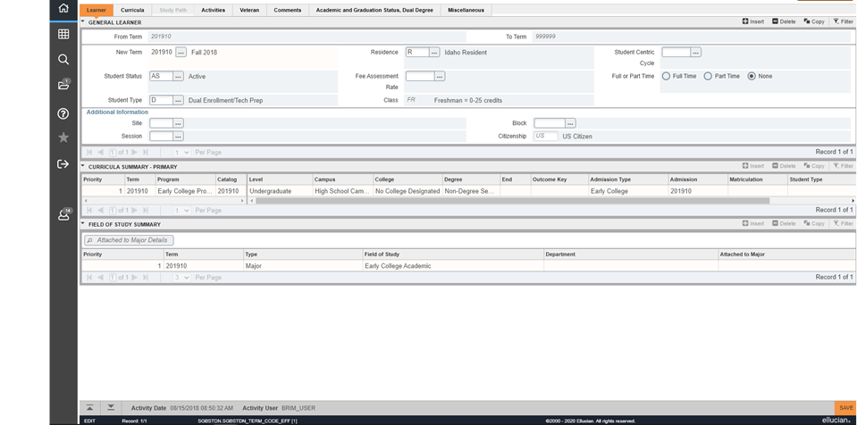
General Student Form
SGASTDN
Notes:
Important Dates Calendar that list each course term and the registration, drop, withdrawal and grading deadlines. Each of these Codes fit into our ISU semesters (basically we register Trimester 2 courses in the Fall semester)
We have all instructors upload a class roster to the box in a specific file. This class roster gives us the student name, how they are completing a pre-req (no scores just ACT, SAT, GPA or ALEK’s), if they have applied, if we have received their permission form ect. This is a two way document that is very informative. Instructors can then confirm their course roster in their faculty BengalWeb account.
I remind instructors to check their rosters at least 2-3 times on and around the deadline date. This helps to catch any registration errors (transposed numbers, this isn’t my student Chelsie) and can be fixed before we get to grading
Grading is completed just as faculty on campus grade

Slide 8
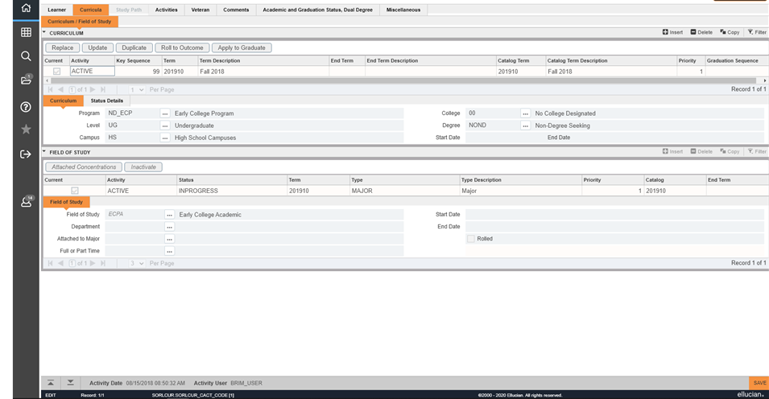
General Student Form
SGASTDN
Notes:
Important Dates Calendar that list each course term and the registration, drop, withdrawal and grading deadlines. Each of these Codes fit into our ISU semesters (basically we register Trimester 2 courses in the Fall semester)
We have all instructors upload a class roster to the box in a specific file. This class roster gives us the student name, how they are completing a pre-req (no scores just ACT, SAT, GPA or ALEK’s), if they have applied, if we have received their permission form ect. This is a two way document that is very informative. Instructors can then confirm their course roster in their faculty BengalWeb account.
I remind instructors to check their rosters at least 2-3 times on and around the deadline date. This helps to catch any registration errors (transposed numbers, this isn’t my student Chelsie) and can be fixed before we get to grading
Grading is completed just as faculty on campus grade

Slide 9
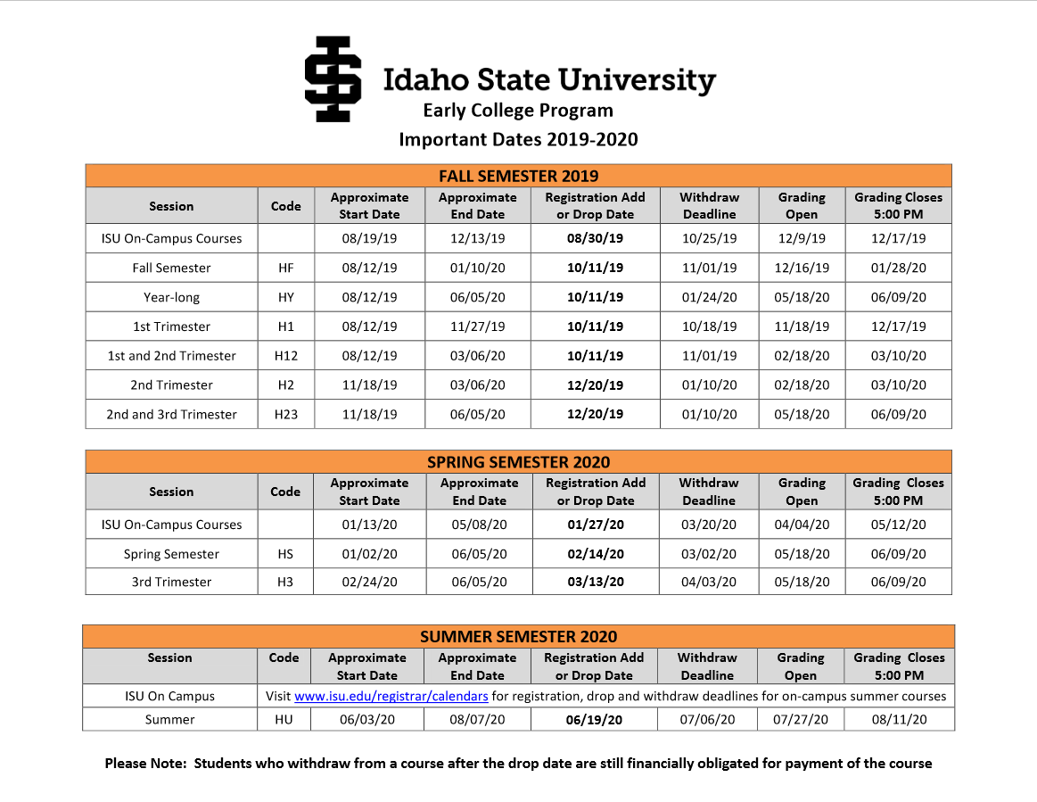
Important Dates Calendar
Notes:
This is the most important part of how we make this work! We have so many schools with different schedules!

Slide 10
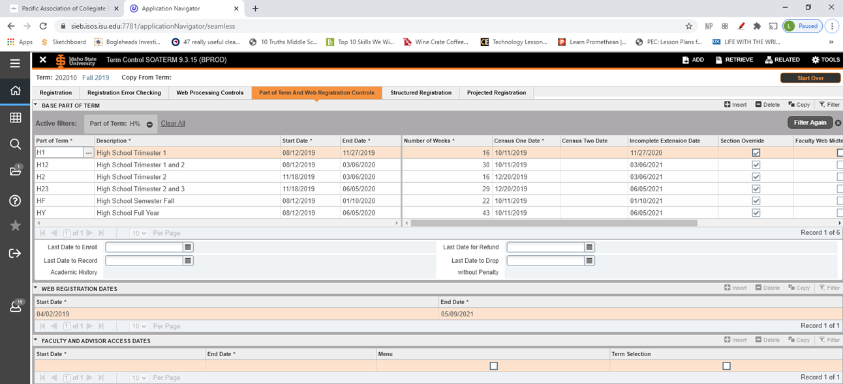
Date Set up in Banner
Form SOATERM
Notes:
This is the most important part of how we make this work! We have so many schools with different schedules!

Slide 11
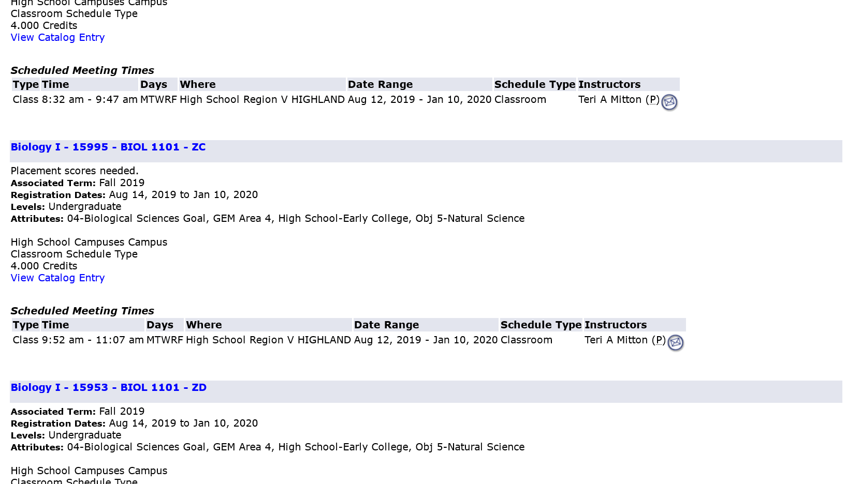
Class Scheduling
Notes:
High school courses are designated by a “Z” when scheduled.

Slide 12
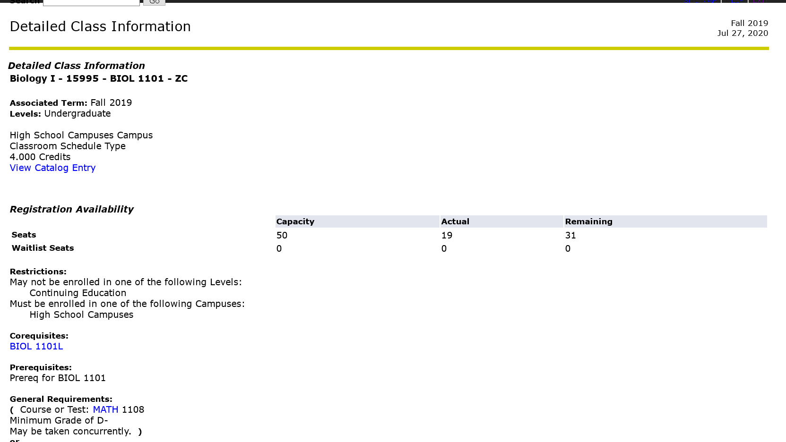
Detailed Class Info

Slide 13
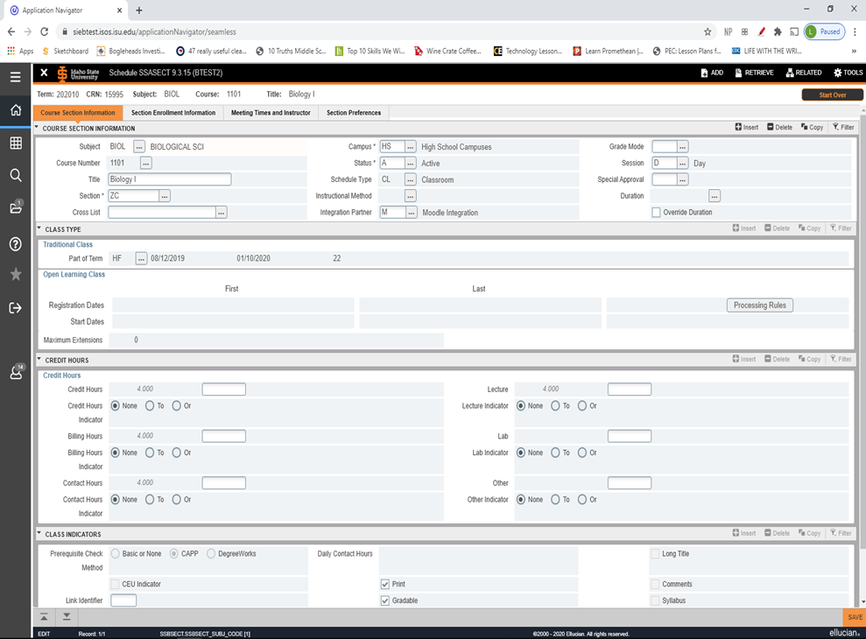
Class Scheduling
Form SSASECT
Notes:
High school courses are designated by a “Z” when scheduled.
The campus is set to HS
You can see the Part of Term on this form as well

Slide 14
Course Registration Permission and Restrictions
While we do want concurrent enrollment students to be able to register in the “Z” sections we don’t want them to be able to register in the non concurrent enrollment sections.
The vice versa is true as well.
To accomplish this we use an include statement when we set up the schedule restrictions on the section.

Slide 15
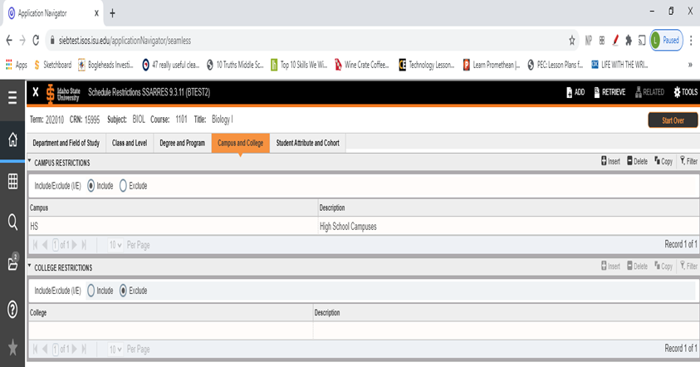
Course Registration Permission and Restrictions
SSARRES
(Remember the HS campus from SGASTDN)

Slide 16
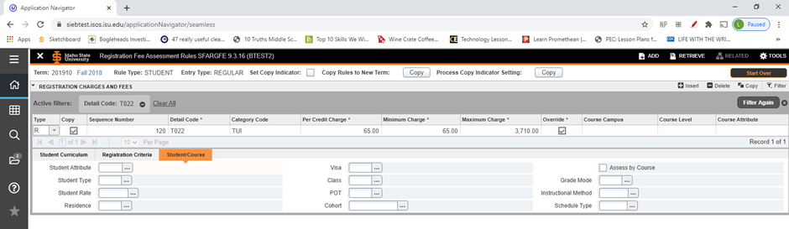
Billing the Discounted Per Credit Rate – Form SFARGFE
(Remember the curriculum from SGASTDN)
Rule is built on SFARGFE to charge every student with ND_ECP the per credit charge.

Slide 17
Questions?

