Slide 1
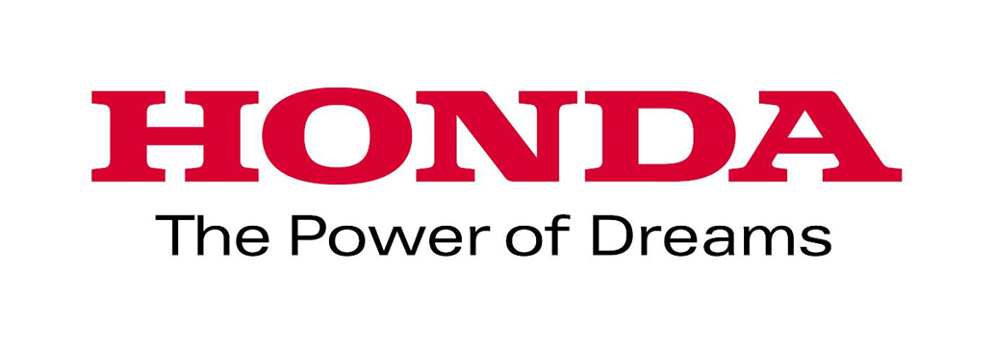
Scot McLemore-Manager of Talent Acquisition
Honda North America
Nichole Braun
Advisor, Business and Engineering Technologies
Columbus State Community College
Notes:
Good morning and thank you all for attending our session.
My name is Scot McLemore and I am Manager of Talent Acquisition for Honda North America.
And I am Dr. Nichole Braun, Advisor, Business and Engineering Technologies at Columbus State Community College.

Slide 2
Disrupt and Rethink Pathways
Notes:
The traditional pathway for students taking advantage of Dual enrollment options or CCP at Columbus State is to take classes aimed at completing the Associate of Arts or Associate of Science degree.
Today, we are “aiming to misbehave” and are here to disrupt the “status quo” by stepping into the raging river of the traditional pathway to a four year university.

Slide 3
Dual Enrollment Pathways
There are multiple options
Notes:
We hope to divert some of the flow into a pathway of career ready success.
You may be curious about what that looks like, so let us introduce you to Brandon:

Slide 4
Deviation can lead to opportunity
Notes:
Brandon is a student engaged in Project Lead the Way at Southwestern Career Academy.
By participating in PLTW, he will earn college credits through our articulation agreement for about 2-3 engineering technology classes. Similar students at other schools, may alternatively receive CTAGs.
While in his engineering classes at Southwest, he and his parents are invited to attend a special event at Columbus State called Modern Manufacturing Night. Brandon and his parents learned about a special program called the Modern Manufacturing Work Study. He heard that students who come to CSCC and major in electro-mechanical, mechanical and electronic engineering technology have the opportunity to work in manufacturing while completing their second year of school. He got to hear of the opportunity from college official, from student participants and the industries themselves! And he learned that the work study students are paid and that participants who completed the program earned a full time technician position upon graduation!
Brandon recognizes this program as an opportunity for real world working experience and decreased cost of education
Meanwhile, encouraged by the school and his parents, at the same time as participating in PLTW, Brandon is taking advantage of College Credit Plus options. With the proper advising from all partners, he will end up completing some or all of his general education requirements.
After graduating, he starts at Columbus State with as many as 27 semester hours already completed. Having done all of this before entering college, his load will be significantly lighter as he participates in the work study and he will spend significantly less on tuition.

Slide 5
One size does not fit all
Notes:
But what about Becky? She isn’t at a Career Academy, a STEM school, or a school with any special engineering programs or classes. She attends a mainstream or college prep high school. Your question may be “Can she still participate and take advantage of the Modern Manufacturing Work Study program in engineering technology?”
In Becky’s case it is obvious to her parents, teachers and her counselors that she is strong in math, likes science and is curious about how things work.
The teachers and counselors were invited to and attended Modern Manufacturing Night and suggested that Becky meet with an advisor and learn more about the program.
When she meets with the advisor, she learns that she can take all her general education requirements via dual enrollment. In addition, in her senior year, she can start taking the engineering classes, interview for her work study position and complete the first year of the program before she even graduates from high school!
If hired, Becky will begin the work study portion of her program in the summer after her high school graduation.

Slide 6
Without the weight of debt
Notes:
This is a great opportunity for students to streamline their path to a career in engineering that is in high demand, has good salaries and benefits. Students who pursue this pathway will minimize the college debt traditionally experienced in our society.
However, this program, the Modern Manufacturing Work Study, wasn’t just created with the student in mind

Slide 7
Synchronized Collaboration
Manufacturing Industry
High School
College
Notes:
Industries’ need for talent prompted collaboration between high Schools, colleges and manufacturers. An increased requirement for skills is needed to maintain today’s manufacturing equipment. Manufacturing Technology has changed drastically over the last ten years and continues to become more complex and high tech.

Slide 8
Bold Action to Compete
Notes:
Today, an increasing number of current manufacturing technicians are nearing retirement eligibility each year and an insufficient number of people are choosing pathways which lead to manufacturing careers, so without bold action the manufacturing industry will experience severe shortages that will lead to an inability to compete in the global market.

Slide 9
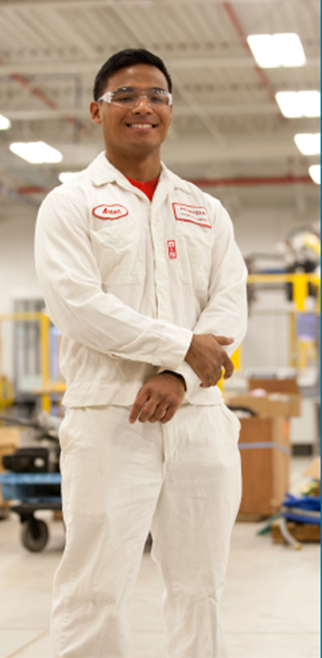
Followed the path to Success!
Notes:
We are excited to share this option and encourage more collaboration in an effort to connect College Credit Plus with the Modern Manufacturing Work Study.
Thank you!
What questions do you have?

Slide 10
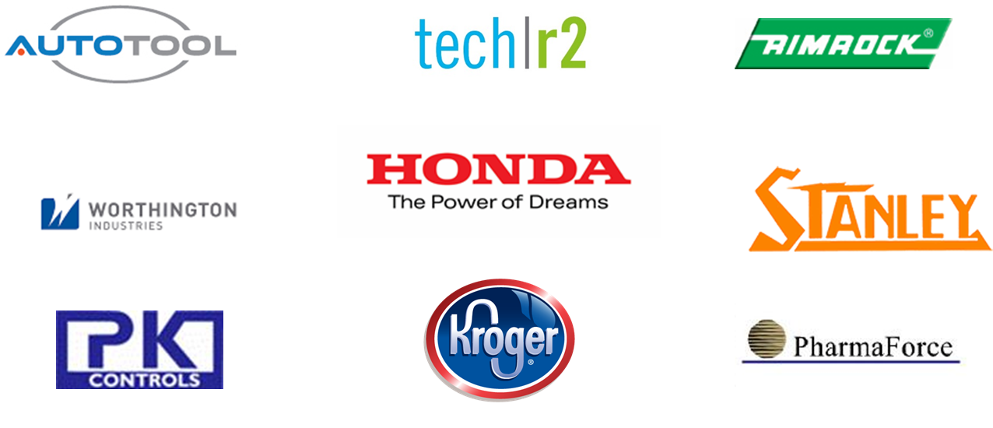
Industry Partners

